Slide 1


MEDISCAN AI NM Olifant dm Mgcina k Kuape t Ncamiso

Slide 2

iNTRODUCTION
MediScan AI is a mobile-based AI prototype designed to help users:
Check symptoms
Upload test reports
Receive early diagnosis feedback
Goal: Improve access to healthcare insights and reduce delays in early detection.

Slide 3

problem STATEMENT: Many patients delay visits due to uncertainty about their symptoms. Overcrowded clinics reduce consultation time. Lack of early diagnosis leads to worsened chronic illness outcomes.

Slide 4

Target Users
General public with limited access to health professionals
Patients with chronic conditions (e.g., diabetes, hypertension)
Rural healthcare centers needing AI-based triage tools

Slide 5

Features of MediScan AI
Secure login for personalized access
Dashboard with easy access to features
Symptom input via natural language
Medical report upload feature (images)
AI-driven prediction with confidence level and recommendation

Slide 6
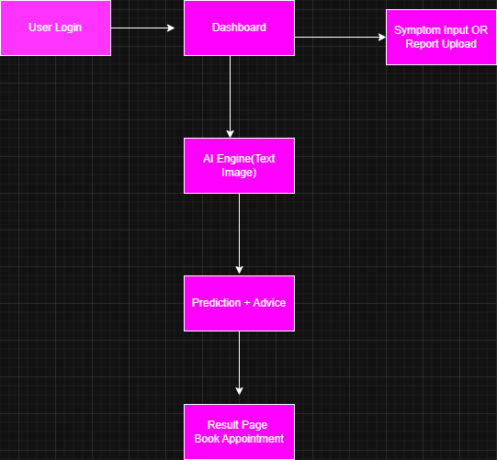
Data Flow Diagram

Slide 7

Ethical Considerations
Ethical Considerations
Bias: Ensuring diverse training data
Privacy: Data encryption and user consent
Accessibility: Mobile-first design, voice support (planned)
Environment: Using light-weight models to reduce energy use
Unintended Impact: Includes human review option to prevent misdiagnosis

Slide 8

Prototype Demo
Walkthrough of:
Login
Dashboard
Symptom input
Upload + AI prediction
Appointment button

Slide 9
Benefits and future Plans
Reduces clinic congestion
Empowers users to manage their health
Promotes early detection of chronic illnesses
Scalable for clinics, NGOs, and rural outreach programs
Add live chat with nurse or AI assistant
Translate app into multiple languages
Connect with local clinics/hospitals for follow-ups

Slide 10

Thank you
Questions & Answers
Contact: nombulelo.olifant@capaciti.org.za
duduzile.mgcina@capaciti.org.za
kutlwano.kuape@capaciti.org.za
thandazile.ncamiso@capaciti.org.za

